Slide 1

Assignment 5:
Dota World of Warcraft
Team : Sudheer Goutham
Hemanth Uppuluri

Slide 2

Docker Restful Web APIs
Used Docker Toolbox, Windows, Node.Js,Angular 8
APIs retrieve the following data
Data of all Hero’s
Hero by Hero’s ID
Hero’s Power
Power by Power number
Uses GET and POST Request

Slide 3
Data Model
The data model I created is based on HERO’s and their Powers
There are some Hero’s with Hero ID
Each Hero has a Name, Localised_name, Powers
Each Hero has two types of Powers
Hierarchy of the Data model next

Slide 4
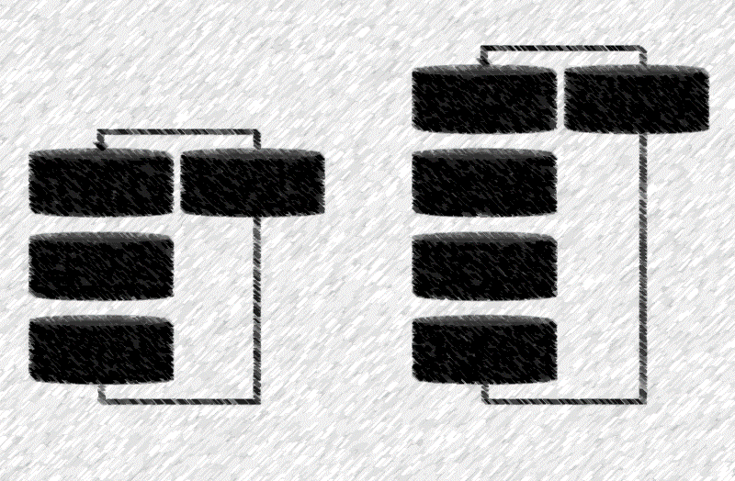
Data Model Hierarchy
Empires:
Hero ID
Localised Name
Power
Power :
Hero ID,
Power:
Power-1,
Power - 2

Slide 5
Thank You !

